Slide 1
Advanced Computer Architecture
Wen-Jyi Hwang
黃文吉

Slide 2
Office Hour:
Tuesday 09:00 to 11:00
Wednesday 09:00 to 11:00
Email: whwang@ntnu.edu.tw
Tel: 02-7749-6670

Slide 3
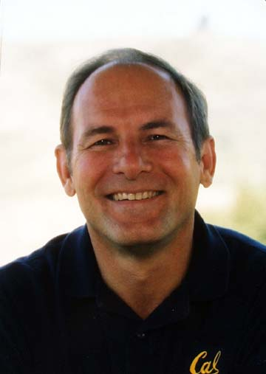
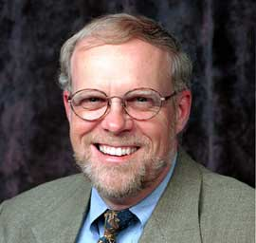
Textbook
Computer Architecture
A Quantitative Approach, 6th Ed.
John L. Hennessy and David A. Patterson
(請用正版教科書)

Slide 4
References
Computer Organization and Design
The Hardware/Software Interface
David A. Patterson and John L. Hennessy
Advanced Computer Architecture
Parallelism, Scalability and Programmability
Kai Huang

Slide 5
Outline(1)
Fundamentals of Quantitative Design and Analysis (Chap. 1)
Instruction Set Principles and Examples (Appendix A)
Pipelining: Basic and Intermediate Concepts (Appendix C)
Instruction-Level Parallelism and Its Exploitation (Chap.3)

Slide 6
Outline(2)
Data-Level Parallelism in Vector, SIMD and GPU Architectures (Chap.4)
Memory Hierarchy Design (Appendix B and Chap. 2)
Thread-Level Parallelism (Chap. 5)
Other Advanced Topics

Slide 7
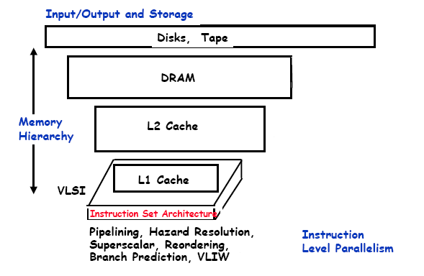
Outline(3)

Slide 8
Grading Policy
Homeworks 20%
Midterm 40%
Final 40%

